Slide 1


Szymon
27.08.2024

Slide 2

Outline
Executive Summary
Introduction
Methodology
Results
Conclusion
Appendix

Slide 3
Executive Summary
Methodologies used:
Data Collection
Exploratory Data Analysis
Feature Engineering
Model Developement
Summary of all results:
Launch site and payload mass were the most influential features in predicting landing success.
Higher success rates observed for RTLS and ASDS landings compared to ocean landings.
Payload mass and launch site location significantly impact landing success.

Slide 4
Introduction
Project background and context:
SpaceX, a pioneering aerospace manufacturer, has revolutionized the space industry with its Falcon 9 rocket, which is partially reusable. This reusability, particularly of the rocket's first-stage booster, significantly reduces the cost of space launches. While SpaceX advertises launch costs at $62 million, competitors often charge upwards of $165 million. The ability to recover and reuse the first stage is a key factor in SpaceX's cost advantage. As the space launch market becomes more competitive, the ability to predict the success of these landings has become increasingly important. Accurate predictions can provide crucial insights for companies looking to compete with SpaceX, enabling them to estimate launch costs and make informed strategic decisions.
Problems you want to find answers:
Can we accurately predict whether the Falcon 9 first stage will land successfully?
What factors most significantly influence landing success?
How can these predictions be used to drive strategic business decisions?

Slide 5

Section 1

Slide 6
Methodology
Executive Summary
Data collection methodology:
Describe how data was collected
Perform data wrangling
Describe how data was processed
Perform exploratory data analysis (EDA) using visualization and SQL
Perform interactive visual analytics using Folium and Plotly Dash
Perform predictive analysis using classification models
How to build, tune, evaluate classification models

Slide 7
Data Collection
The primary data was collected from the Wikipedia page by web scraping: https://en.wikipedia.org/wiki/List_of_Falcon_9_and_Falcon_Heavy_launches using request library and BeautifulSoup.
Additional data points, such as Booster Version, Launch Site, and other relevant launch parameters, were collected using SpaceX APIs.
Collection proces:
Identify Data Sources (Wikipedia and APIs)
Web Scraping (Extract launch data)
API Integration (Enrich data with additional factors)
Data Preprocessing (Cleaning, Handling Missing Data, Format Standardization)

Slide 8
Data Collection – SpaceX API
Data were collected with SpaceX REST API calls using request library.
https://github.com/SzewczykSzy/IBM_DS_Project/blob/main/jupyter-labs-spacex-data-collection-api.ipynb
BoosterVersion = requests.get("https://api.spacexdata.com/v4/rockets/"+str(x)).json() ['name']
LaunchSite = requests.get("https://api.spacexdata.com/v4/launchpads/"+str(x)).json()
PayloadData = requests.get("https://api.spacexdata.com/v4/payloads/"+load).json()
CoreData = requests.get("https://api.spacexdata.com/v4/cores/"+core['core']).json()
spacex_url = "https://api.spacexdata.com/v4/launches/past"

Slide 9
Data Collection - Scraping
At first got page title. Then found important table. Table headers were found. For every row in this table data were colected. All data were appended to lists and transformed to dataframe
https://github.com/SzewczykSzy/IBM_DS_Project/blob/main/jupyter-labs-webscraping.ipynb
static_url = "https://en.wikipedia.org/w/index.php?title=List_of_Falcon_9_and_Falcon_Heavy_launches&oldid=1027686922"
response = requests.get(static_url)
bs = BeautifulSoup(response.text)
bs.find_all('table’)[2]
first_launch_table.find_all('th’)
table.find_all("tr")

Slide 10
Data Wrangling
Data were loaded from previous step.
Identified and calculated the percentage of the missing values in each attribute
Calculated the number of launches on each site
Calculate the number and occurrence of each orbit
Calculate the number and occurance of mission outcome of the orbits
Create a landing outcome label from Outcome column
https://github.com/SzewczykSzy/IBM_DS_Project/blob/main/labs-jupyter-spacex-Data%20wrangling.ipynb

Slide 11
EDA with Data Visualization
Charts:
Scatter plot of FlightNumber, PayloadMass and Class hue to see how Payload affect outcome.
Scatter plot of FlightNumber, LaunchSite and Class hue to see how LaunchSite affect outcome.
Scatter plot of LaunchSite and PayloadMass and Class hue to investigate if there is some correlation.
Bar chart to visualize the relationship between success rate of each orbit type.

Slide 12
EDA with Data Visualization
Scatter plot of FlightNumber and Orbit type (checking correlation)
Scatter plot of Payload and Orbit type visualize relationship.
Line plot to visualize percentage of success lauches each year.
Bar chart to visualize the relationship between success rate of each orbit type.
https://github.com/SzewczykSzy/IBM_DS_Project/blob/main/jupyter-labs-eda-dataviz.ipynb

Slide 13
EDA with SQL
DROP TABLE IF EXISTS SPACEXTABLE
create table SPACEXTABLE as select * from SPACEXTBL where Date is not null
SELECT DISTINCT(Launch_Site) FROM SPACEXTABLE
SELECT * FROM SPACEXTABLE WHERE Launch_Site LIKE 'CCA%' LIMIT 5
SELECT SUM(PAYLOAD_MASS__KG_) FROM SPACEXTABLE WHERE Customer = 'NASA (CRS)’
SELECT AVG(PAYLOAD_MASS__KG_) FROM SPACEXTABLE WHERE Booster_Version LIKE 'F9 v1.1%’
SELECT MIN(Date) FROM SPACEXTABLE WHERE Landing_Outcome = 'Success (ground pad)’
SELECT DISTINCT(Landing_Outcome) FROM SPACEXTABLE

Slide 14
EDA with SQL
SELECT Booster_Version FROM SPACEXTABLE WHERE Landing_Outcome = 'Success (drone ship)' AND PAYLOAD_MASS__KG_ > 4000 AND PAYLOAD_MASS__KG_ < 6000
SELECT Mission_Outcome, COUNT(Mission_Outcome) FROM SPACEXTABLE GROUP BY Mission_Outcome
SELECT Booster_Version FROM SPACEXTABLE WHERE PAYLOAD_MASS__KG_ = (SELECT MAX(PAYLOAD_MASS__KG_) FROM SPACEXTABLE)
SELECT substr(Date, 6,2), Landing_Outcome, Booster_Version, Launch_Site FROM SPACEXTABLE WHERE substr(Date,0,5)='2015' AND Landing_Outcome ='Failure (drone ship)’
SELECT Landing_Outcome, COUNT(Landing_Outcome) FROM SPACEXTABLE WHERE Date BETWEEN '2010-06-04' AND '2017-03-20' GROUP BY Landing_Outcome Order by COUNT(Landing_Outcome) DESC
https://github.com/SzewczykSzy/IBM_DS_Project/blob/main/jupyter-labs-eda-sql-coursera_sqllite.ipynb

Slide 15
Build an Interactive Map with Folium
I have created and addd `folium.Circle` and `folium.Marker` for each launch site on the site map. Then added the launch outcomes for each site, to see which sites have high success rates. To do this i have used MarkerCluster() and then added Marker()’s. Also added MousePosition() to get Lattitude and Longitude of exact places. By using that i could calculate the distance between places and it to map by Marker() and draw a line by PolyLine() between those places.
https://github.com/SzewczykSzy/IBM_DS_Project/blob/main/lab_jupyter_launch_site_location.ipynb

Slide 16
Build a Dashboard with Plotly Dash
At first i have added a pie chart to show the total successful launches count for all sites. If a specific launch site was selected, the chart shows the Success vs. Failed counts for the site.
The second graph is a scatter chart to show the correlation between payload and launch success.
https://github.com/SzewczykSzy/IBM_DS_Project/blob/main/spacex_dash_app.py

Slide 17
Predictive Analysis (Classification)
At first I have created X dataframe and Y array. Then standarized the X by StandardScalers() and divided dataset into train and test sets.
I have created for differents models: LogisticRegression(), SVC(), DecisionTreeClassifier() and KNeighborsClassifier()
For each model I have created parameters dictionary and use it to find the best set of parameters by using GridSearchCV() with ``cv=10``.
I have fitted models on train data checked accuracy on train set and evaluated them on test set. Most of the models get 83.33% accuracy on the test set. DecisionTreeClassifier got worst 72.22% accuracy. SVC and KNN got the best accuracy on train set: 84,82%.
https://github.com/SzewczykSzy/IBM_DS_Project/blob/main/SpaceX_Machine_Learning_Prediction_Part_5.jupyterlite.ipynb

Slide 18
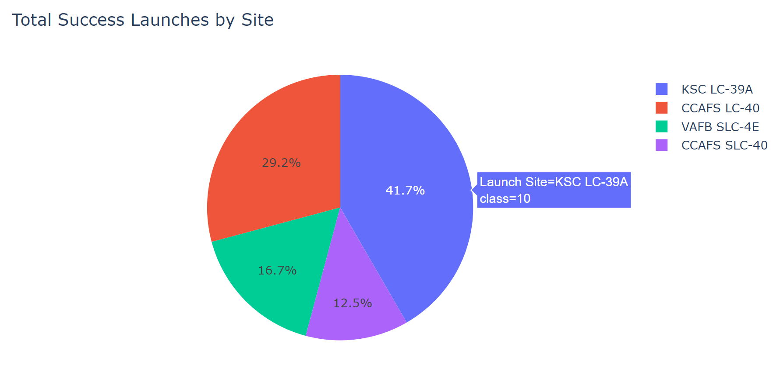
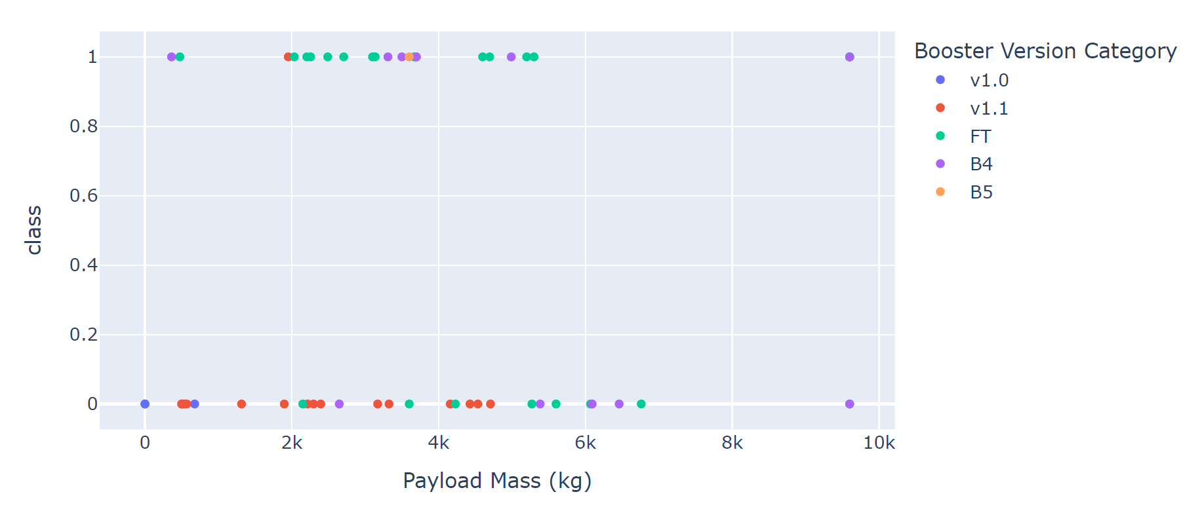
Results
The analysis revealed that the success of Falcon 9 landings is significantly influenced by factors such as the launch site, payload mass, and the type of landing attempt (RTLS, ASDS, Ocean).
All models had the same accuracy of about 83%. Each of the models had a problem with False Postive predictions - 3 were classified wrongly

Slide 19

Section 2

Slide 20
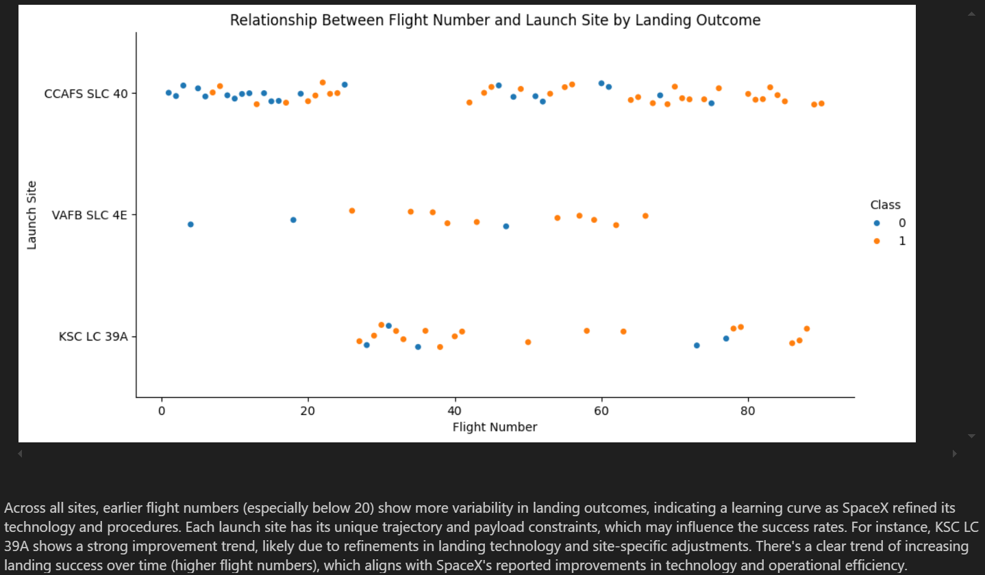
Flight Number vs. Launch Site

Slide 21
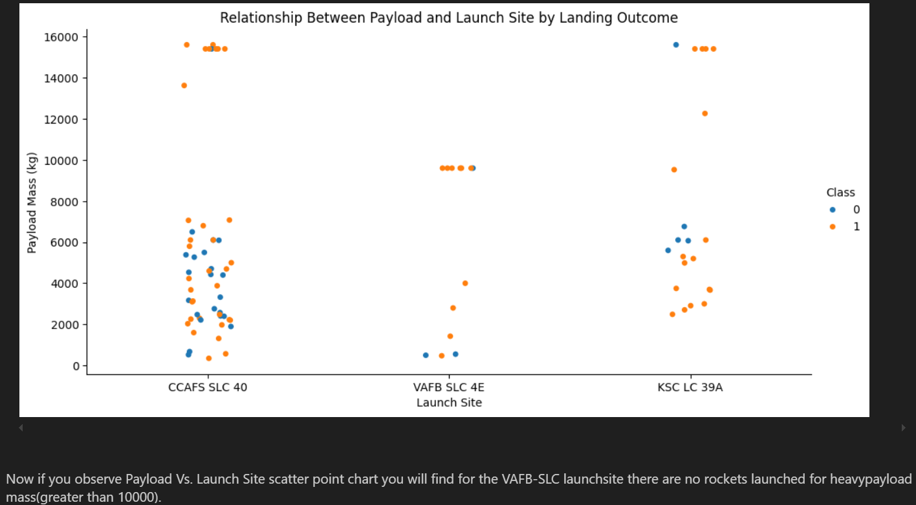
Payload vs. Launch Site

Slide 22
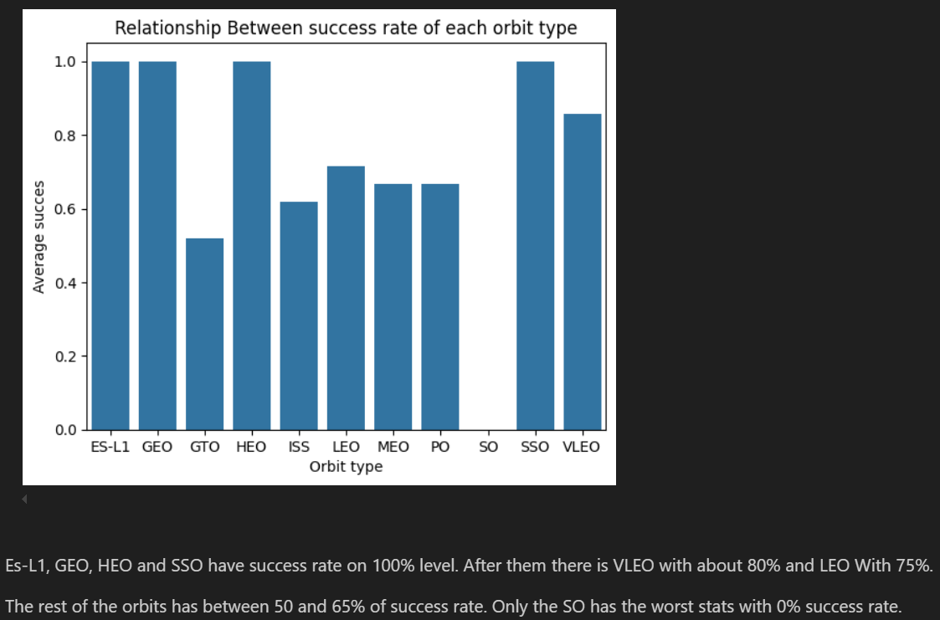
Success Rate vs. Orbit Type

Slide 23
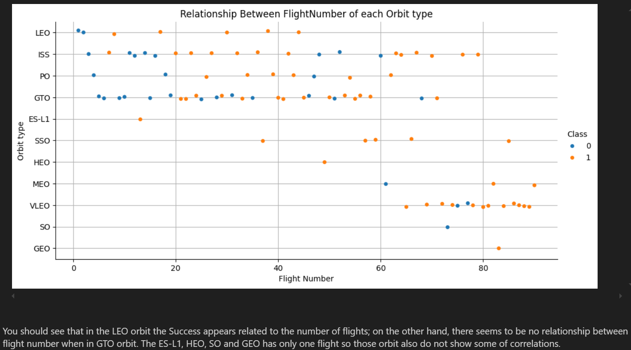
Flight Number vs. Orbit Type

Slide 24
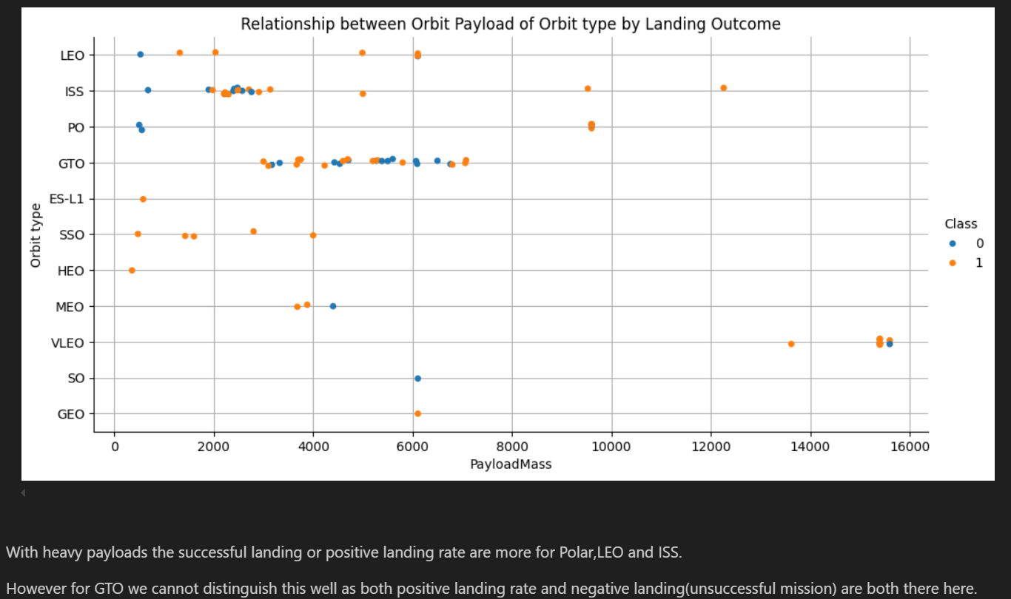
Payload vs. Orbit Type

Slide 25
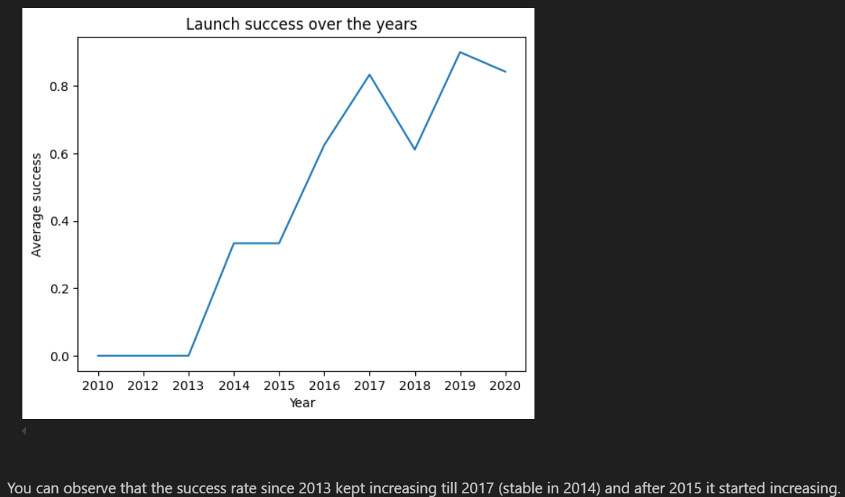
Launch Success Yearly Trend

Slide 26
All Launch Site Names
SELECT DISTINCT(Launch_Site) FROM SPACEXTABLE
There are only 4 unique (distinct) Launch Sites:
CCAFS LC-40
VAFB SLC-4E
KSC LC-39A
CCAFS SLC-40

Slide 27
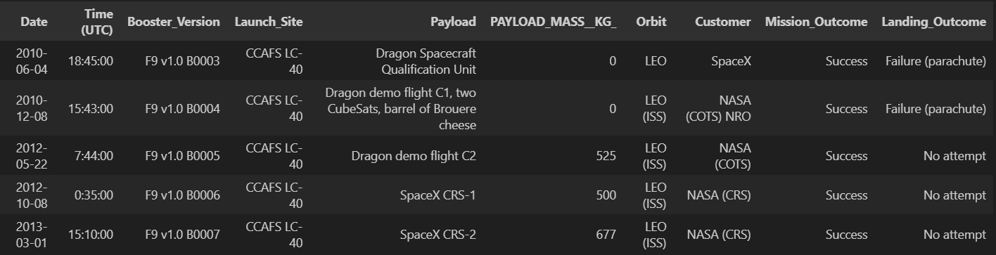
Launch Site Names Begin with 'CCA'
SELECT * FROM SPACEXTABLE WHERE Launch_Site LIKE 'CCA%' LIMIT 5
LIKE expression is used to get results with some subsequences.

Slide 28
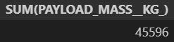
Total Payload Mass
SELECT SUM(PAYLOAD_MASS__KG_) FROM SPACEXTABLE WHERE Customer = 'NASA (CRS)’
Using SUM function with WHERE expression (limitation to ‚NASA (CRS)’)

Slide 29
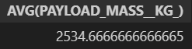
Average Payload Mass by F9 v1.1
SELECT AVG(PAYLOAD_MASS__KG_) FROM SPACEXTABLE WHERE Booster_Version LIKE 'F9 v1.1%’
Usage of AVG function with LIKE expression (limitation to ‚ 'F9 v1.1’)

Slide 30
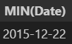
First Successful Ground Landing Date
SELECT MIN(Date) FROM SPACEXTABLE WHERE Landing_Outcome = 'Success (ground pad)’
Finding the first date using MIN Function restricted to Succes ground pad.

Slide 31
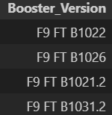
Successful Drone Ship Landing with Payload between 4000 and 6000
SELECT Booster_Version FROM SPACEXTABLE WHERE Landing_Outcome = 'Success (drone ship)' AND PAYLOAD_MASS__KG_ > 4000 AND PAYLOAD_MASS__KG_ < 6000
Using WHERE expression with two AND.

Slide 32
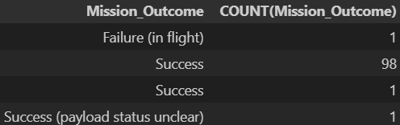
Total Number of Successful and Failure Mission Outcomes
SELECT Mission_Outcome, COUNT(Mission_Outcome) FROM SPACEXTABLE GROUP BY Mission_Outcome
Using GROUP BY statement to group Mission Outcomes and using COUNT function to count Outcomes.

Slide 33
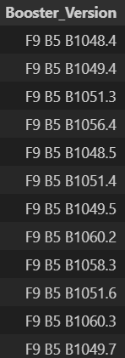
Boosters Carried Maximum Payload
SELECT Booster_Version FROM SPACEXTABLE WHERE PAYLOAD_MASS__KG_ = (SELECT MAX(PAYLOAD_MASS__KG_) FROM SPACEXTABLE)
Using WHERE expression with nested SELECT query (max payload)

Slide 34
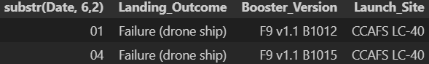
2015 Launch Records
SELECT substr(Date, 6,2), Landing_Outcome, Booster_Version, Launch_Site FROM SPACEXTABLE WHERE substr(Date,0,5)='2015' AND Landing_Outcome ='Failure (drone ship)’
Substr(Date, 6, 2) – month number. Using WHERE expression with substr() function and AND.

Slide 35
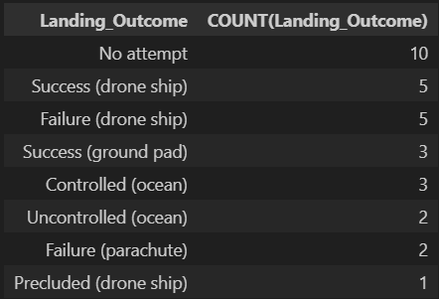
Rank Landing Outcomes Between 2010-06-04 and 2017-03-20
SELECT Landing_Outcome, COUNT(Landing_Outcome) FROM SPACEXTABLE WHERE Date BETWEEN '2010-06-04' AND '2017-03-20' GROUP BY Landing_Outcome Order by COUNT(Landing_Outcome) DESC
Using GROUP BY statement to group by Landing Outcome, WHERE expression to filter results by date and ORDER BY COUNT() DESC to get final result.

Slide 36

Section 3

Slide 37
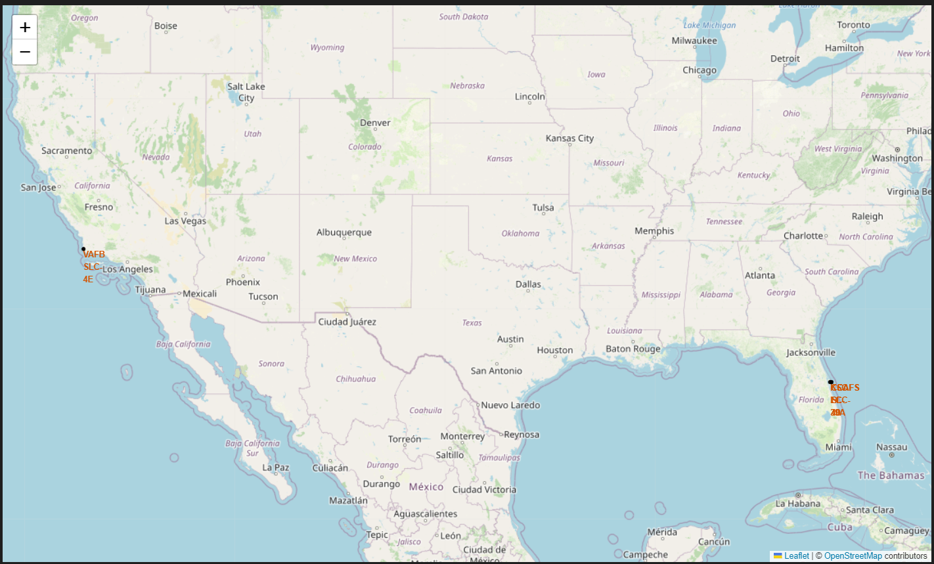
Launch sites’ locations
The Lauch sites globally take place it two regions. One is on the west coast of the USA and the secont one is on the east cost.

Slide 38
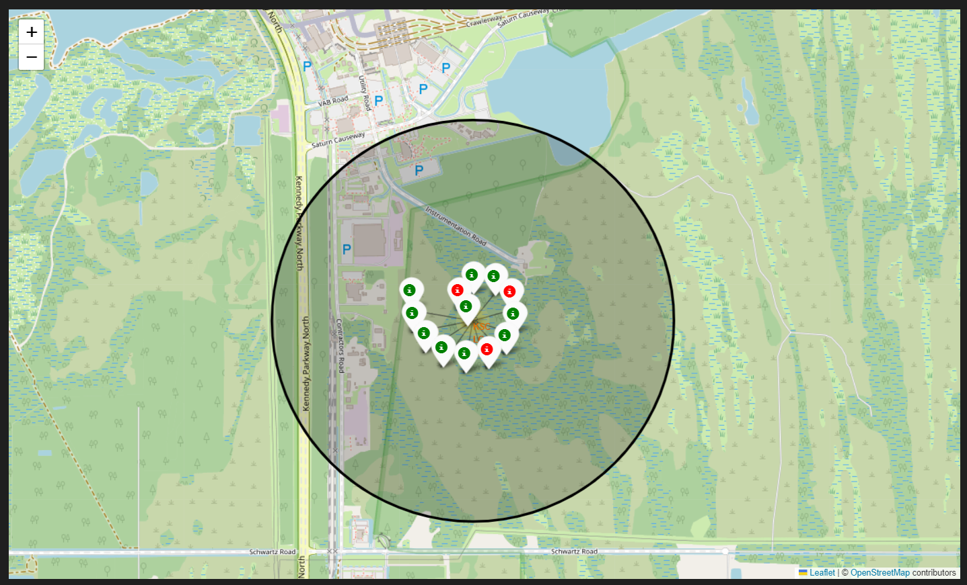
Color-labeled launch outcomes
The map shows one area of launch sites. It represand the launchase with color-labeled marks represanting outcome:
Green – success
Red – fail

Slide 39
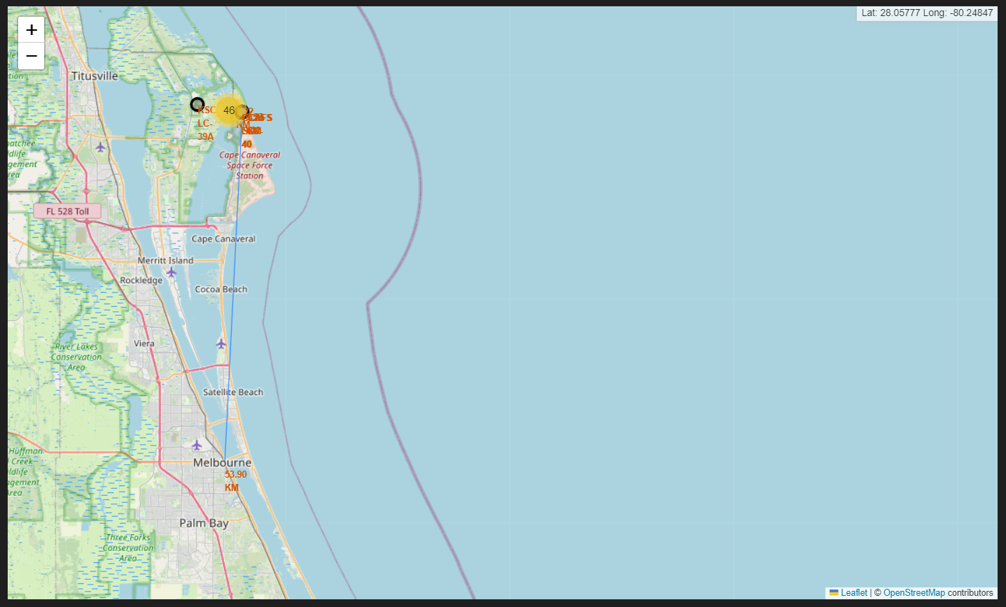
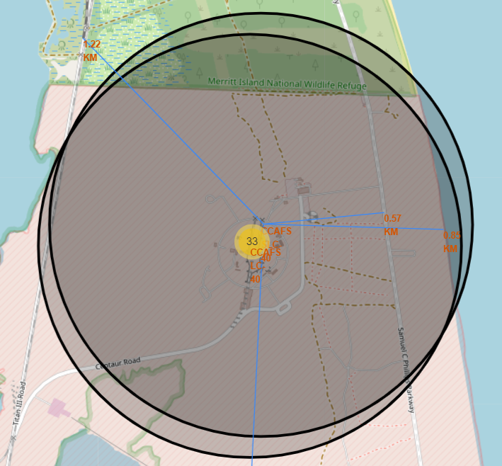


Distance to railway, highway and coastline
Map shows distances to the nearest places:
City – Melbourne 53.9 km
Railway – 1.22 km
Highway – 0.57 km
Coastline – 0.85 km

Slide 40

Section 4

Slide 41
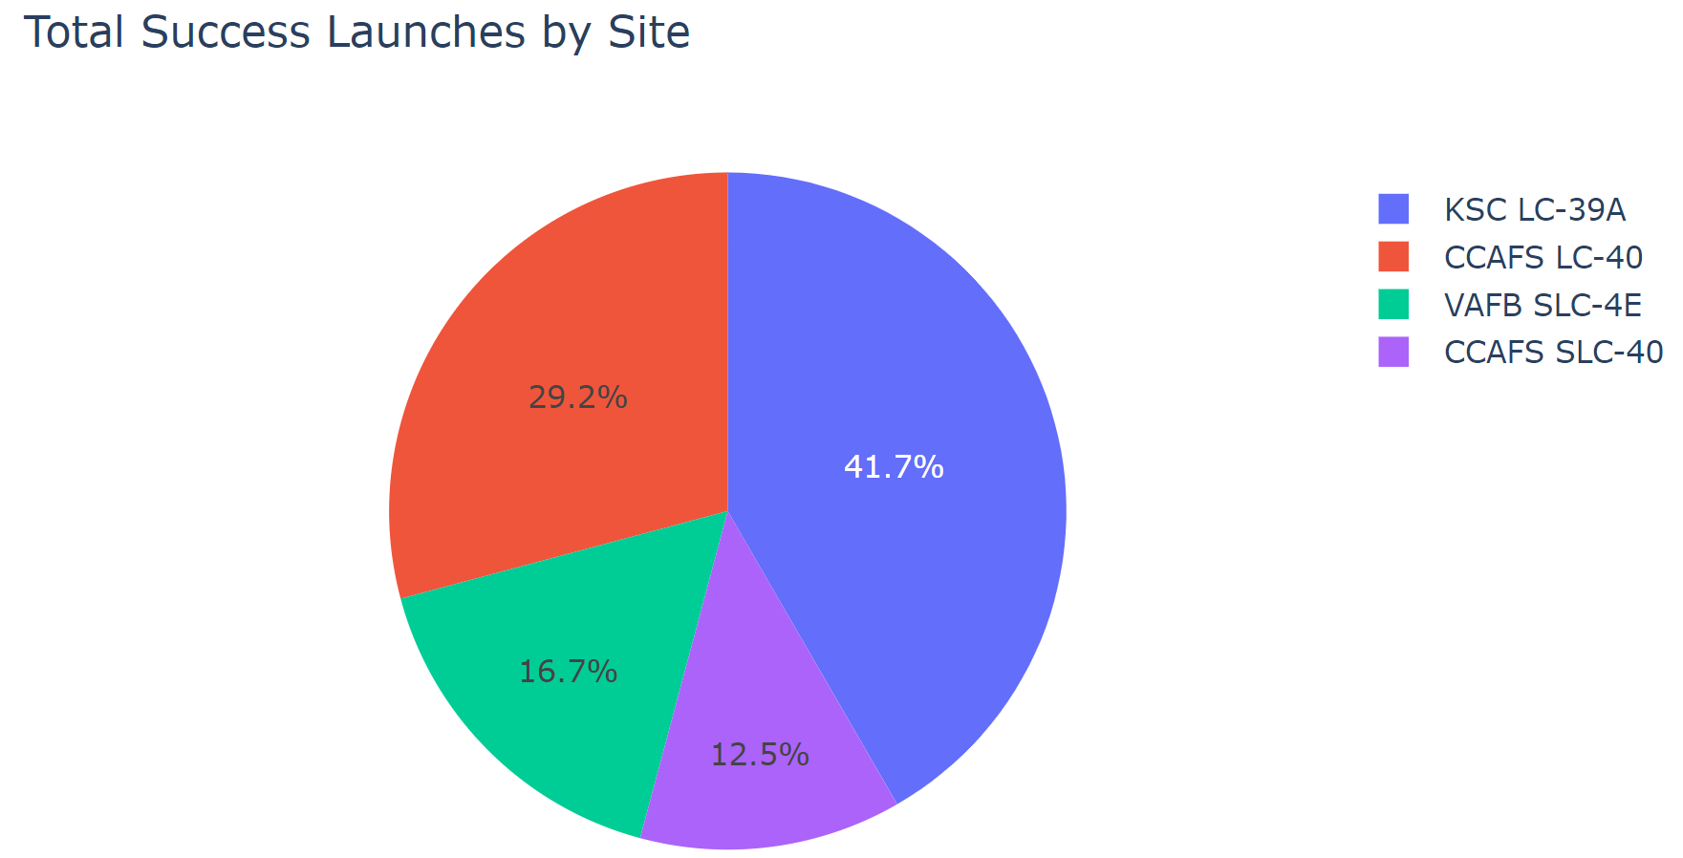
Launch success count for all sites
The most success launches made from KSC LC-39A (41.7%) and the least from CCAFS SLC-40 (12,5%).

Slide 42
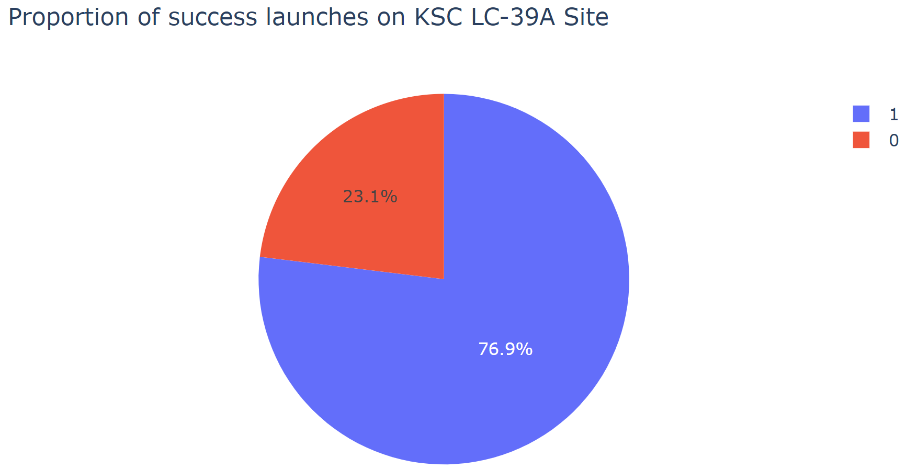
Highest launch success ratio
The most successful launch site was KSC LC-39A with 76.9% of success launches.

Slide 43
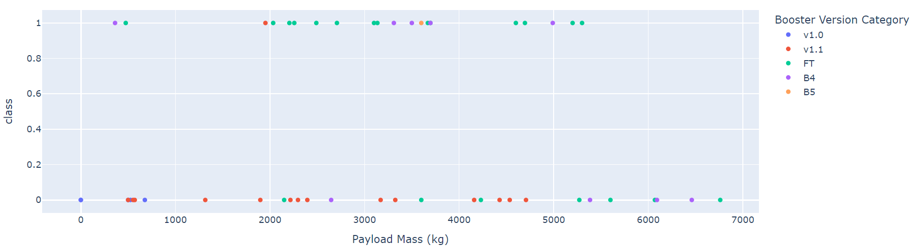
Payload vs. Launch Outcome
The highest success ratio has B5 Booster, but it contains least of all launches. At second place there could be FT and B4. At the Payload range (0-4000) the most successfull is FT.

Slide 44

Section 5

Slide 45
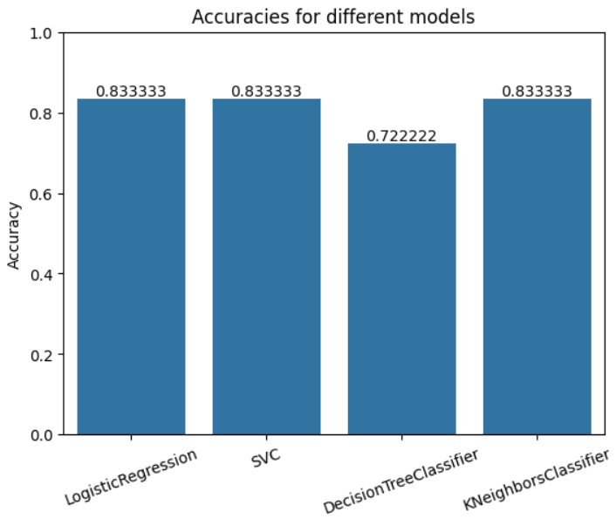
Classification Accuracy
Three out of four models has highest validaion accuracy 83.33%. When it comes to training accuracy the differences are small, but the best is DecissionTree (86%) which could indicate overfitting.

Slide 46
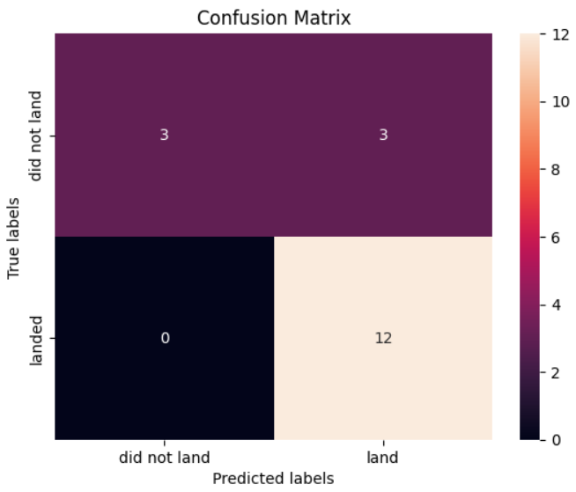
Confusion Matrix
Ale the models with 83.33% validation accuracy made the same mistakes. There is one problem of False Postives – 3 (True label is not landed, Predicted label is landed)

Slide 47
Conclusions
In conclusion, this project demonstrates that the success of SpaceX Falcon 9 landings can be effectively predicted by analyzing key factors such as launch site, payload mass, and the type of landing attempt (RTLS, ASDS, Ocean). The models built showed a consistent accuracy of around 83%, though they encountered challenges with false positive predictions. The insights gained through this analysis are vital for stakeholders in the aerospace industry, as they enable better decision-making processes, particularly in estimating launch costs and strategizing for competitive advantage in the space launch market.

Slide 48
Appendix
The appendix contains various supplementary materials that were crucial for the development and validation of this project. This includes Python code snippets, SQL queries, detailed data visualizations, and outputs from Jupyter Notebooks used throughout the project. Key assets included in this appendix:
Python scripts for data collection via web scraping and API integration.
SQL queries used for data preprocessing and exploratory data analysis.
Data visualizations such as scatter plots, bar charts, and interactive maps created using Plotly and Folium.
Details of the machine learning models used, including their respective parameters, training, and validation processes.
Confusion matrices showcasing the performance of each model.
These resources provide a comprehensive understanding of the methodology and tools utilized, ensuring the reproducibility of the study and offering a deeper dive into the technical aspects for interested parties.

Slide 49


